Slide 1


What are the consequences of having burdensome rail booking processes? Here’s what people from 7 Europeans countries think
An opinion poll by YouGov on behalf of T&E
07/10/2025

Slide 2

Executive summary
Barriers to booking are pushing passengers away from trains. This is according to an opinion poll responded by more than 10,000 citizens from seven European countries. The EU can fix this.
Currently rail operators are under no obligation to display competitors’ journeys on their own booking platforms, or to provide their own on other platforms. The EU’s Single Ticketing Package plans to unlock seamless rail ticket booking.
It will also decide if passengers should be allowed to jump on the next train without extra cost in case of a missed connection due to delays even if the trains are from competing operators, and whether or not to include the journey’s climate footprint for all transport options in the engine search.
What are Europeans’ preferences for rail:
Almost two out of three long-distance rail users encountered difficulties while booking tickets.
Guaranteed connections, ease of long-distance tickets reservation and visibility for all fare types in booking websites are top concerns of passengers.
43% of long-distance rail passengers would increase their travelling if ticket booking was easier.
| Opinion poll - rail booking and ticketing

Slide 3
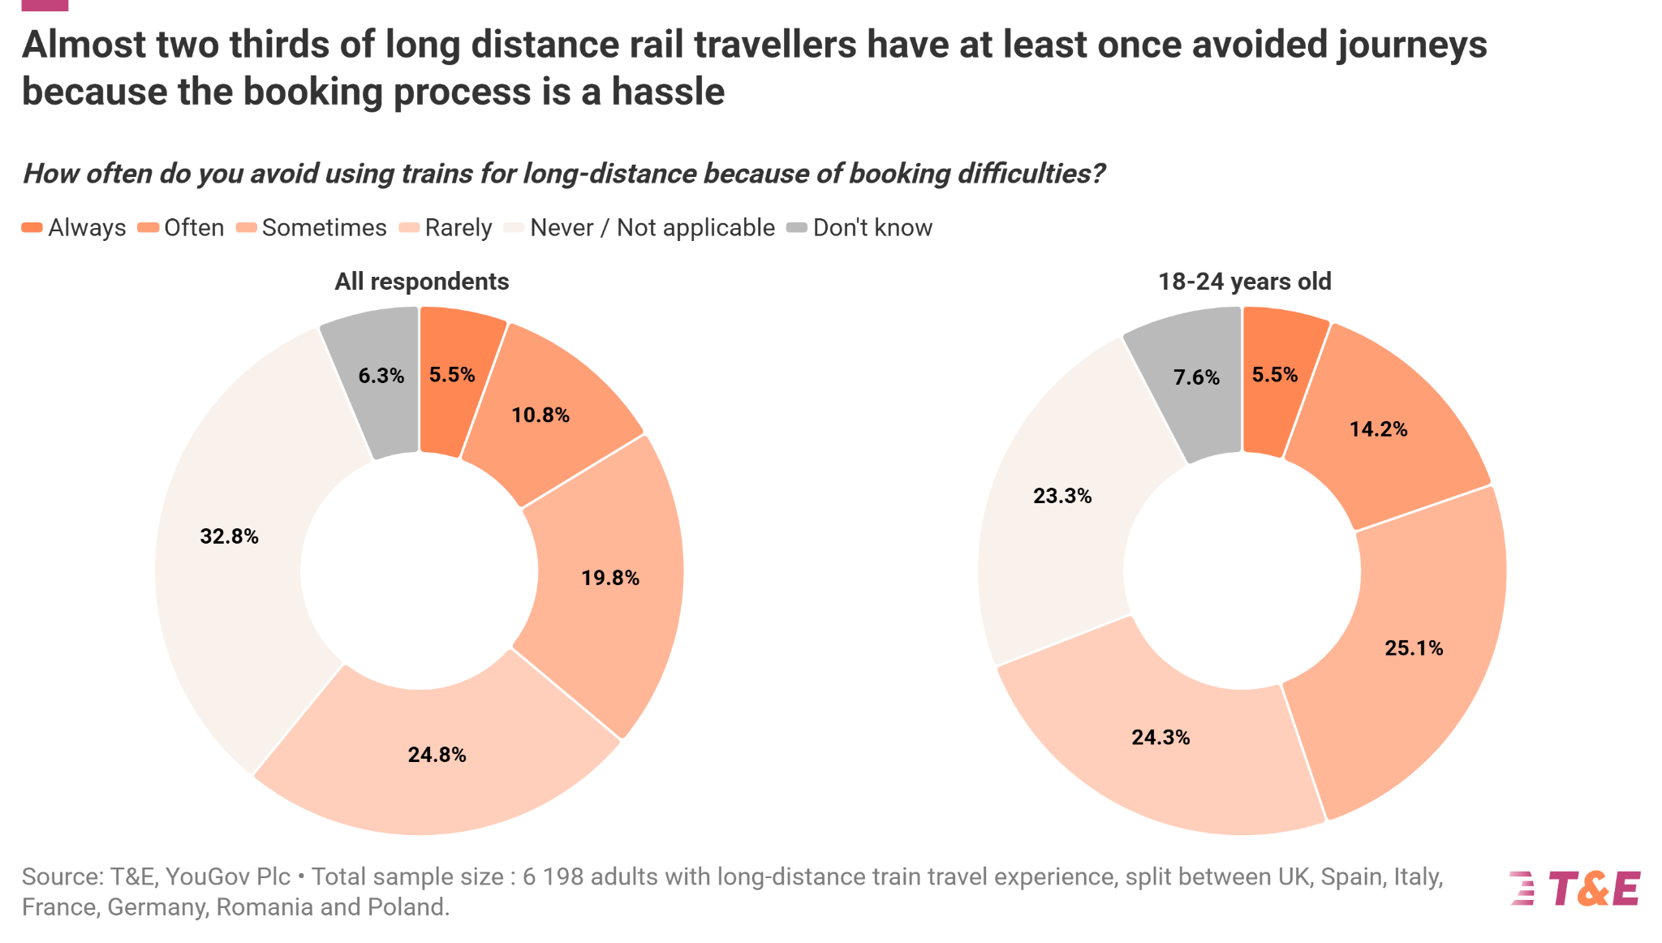

Almost two thirds of long distance rail travellers have avoided journeys due to booking hassle at least once
Online booking difficulties have stopped almost two in three respondents (61%) from taking the train

Slide 4
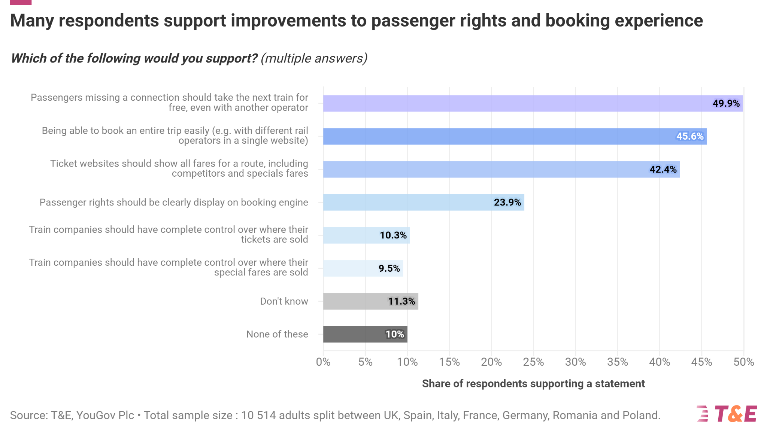
Many respondents support improvements to passenger rights and booking experience
The share of those who would like a seat on the next train guaranteed in case of missing the connection due to a delay is greatest (50%)
The desire for simplification is clear: 42% of participants wish to access more travel options, and 46% want to have it easier when booking across platforms…
… while only 10% support the current ticketing system

Slide 5
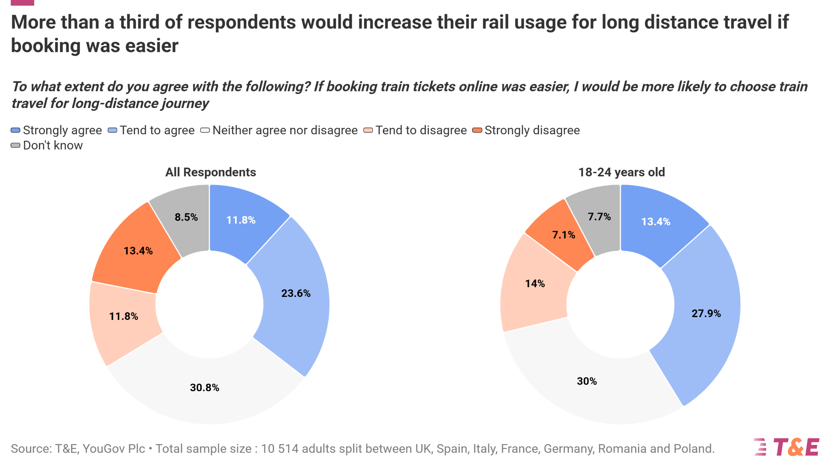
More than a third of respondents would increase their rail usage for long distance travel if booking was easier
An easier booking process would get more people on trains. 35% of participants in the poll agreed that they would opt for rail more often if ticketing were simplified.

Slide 6
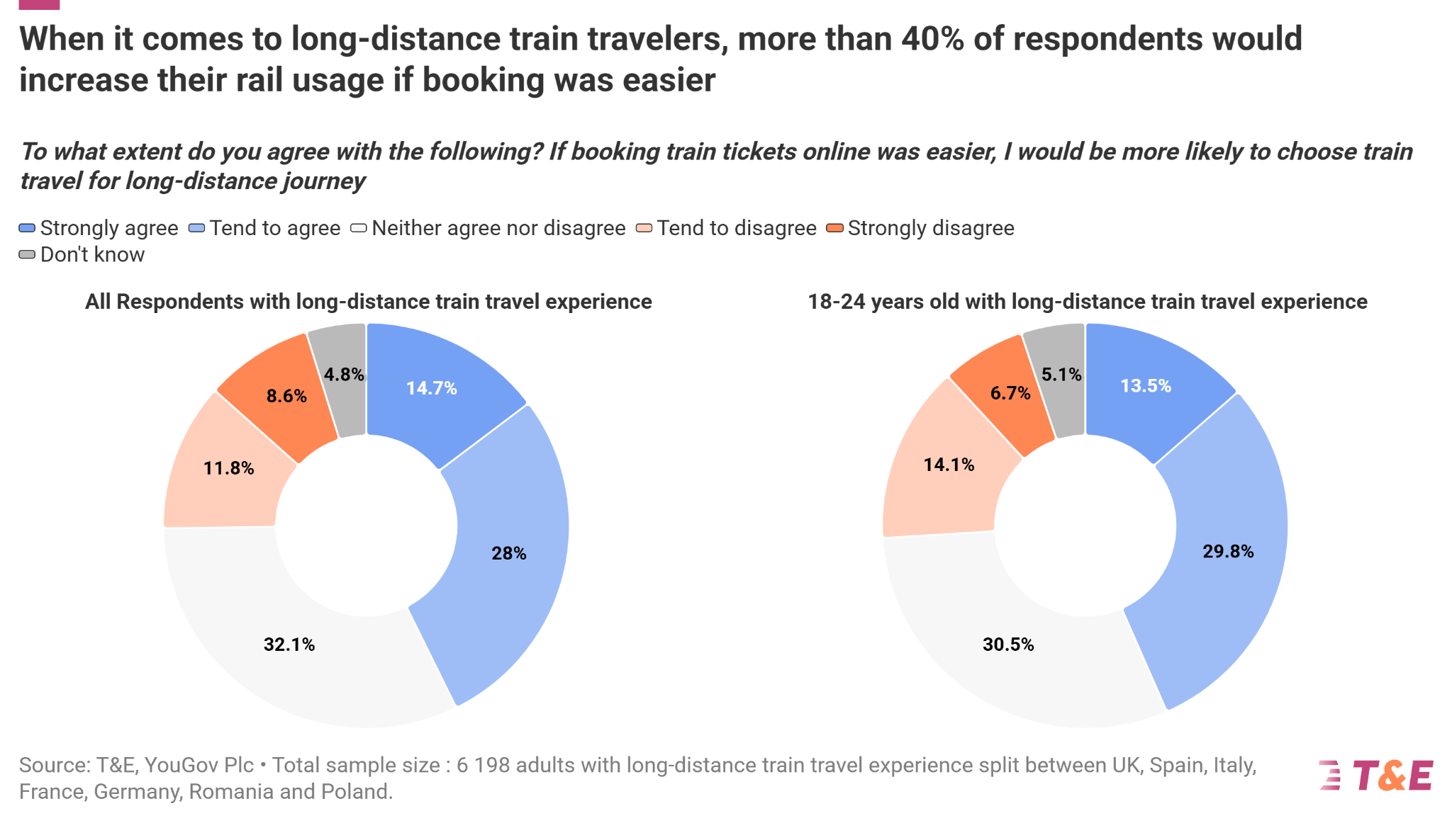
When it comes to long-distance train travelers, more than 40% of respondents would increase their rail usage if booking was easier
This share is even greater for those respondents who already used rail for long distance journeys in the past. 43% of these would like to see that change happening.

Slide 7
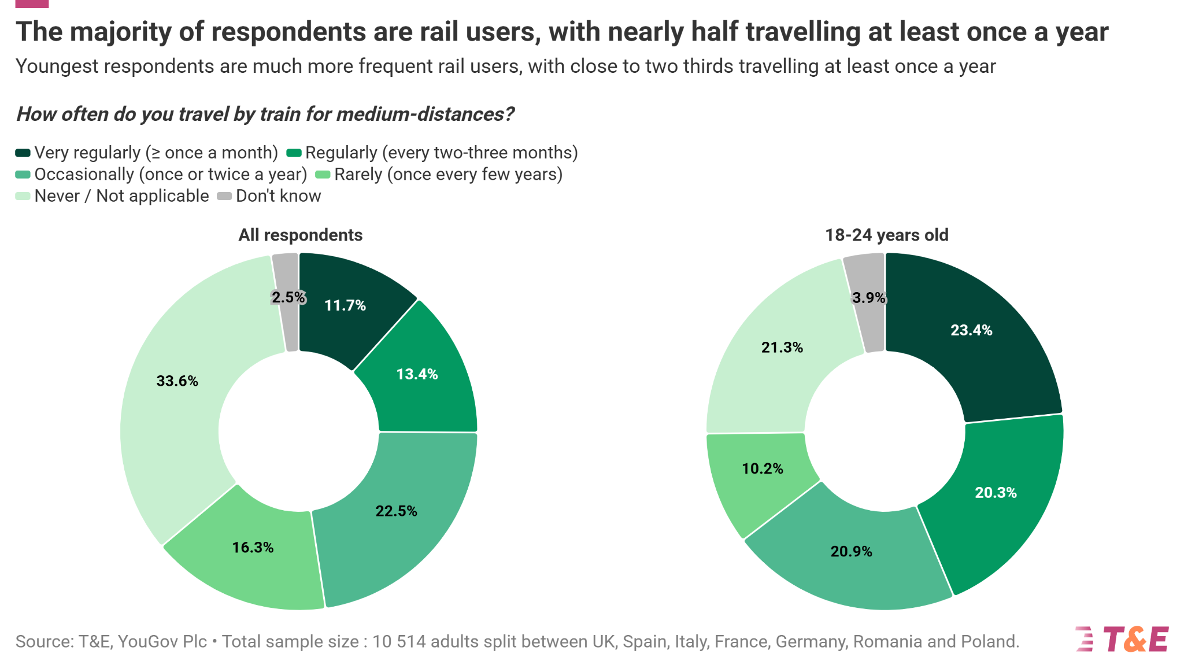
The majority of respondents are rail users, with nearly half travelling at least once a year
This goes up to two out of five young people who take the train regularly
One in four respondents use rail regularly for travelling medium distances.

Slide 8
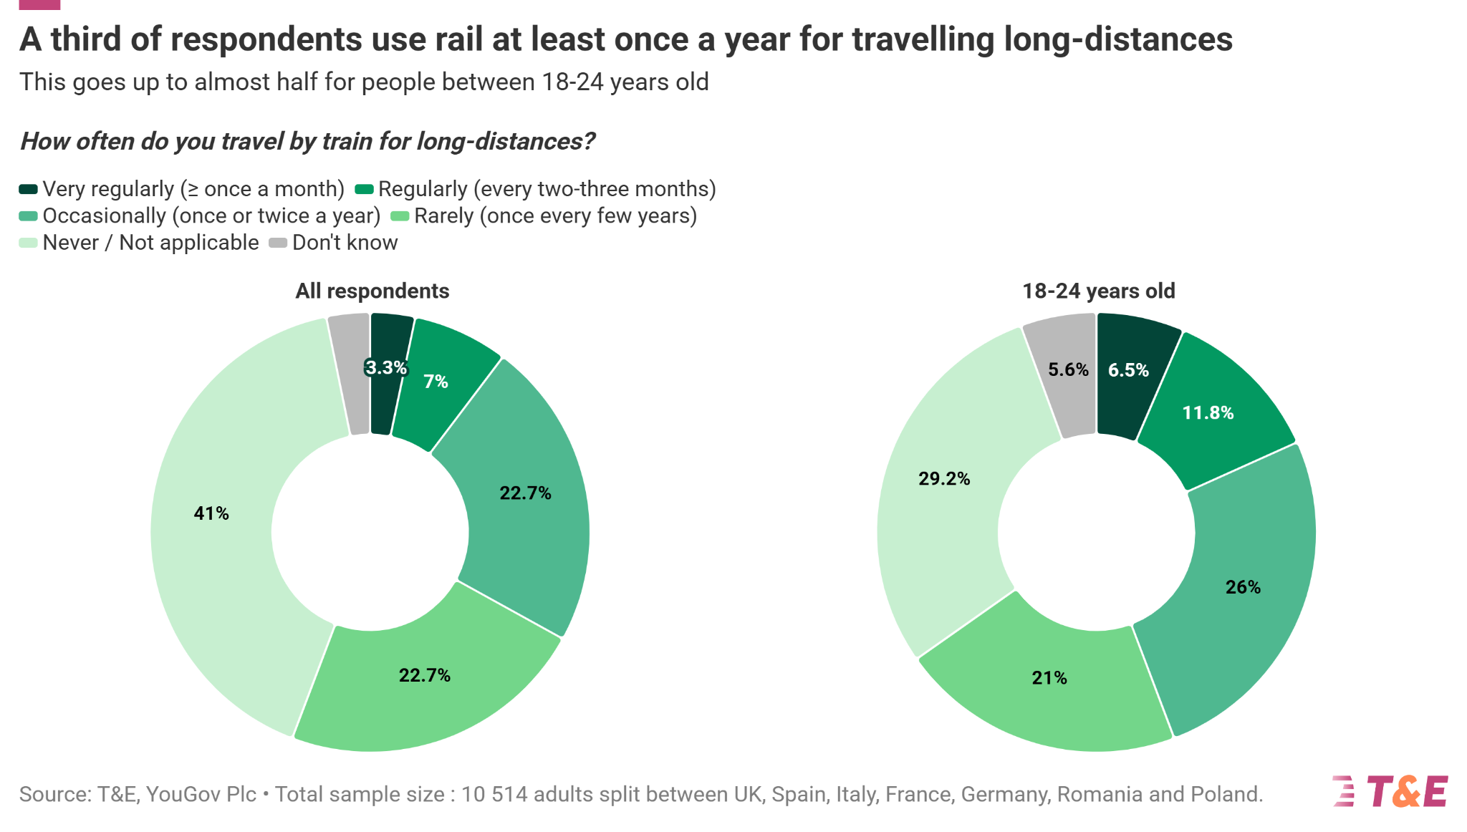
A third of respondents use rail at least once a year for travelling long-distances
Rail travelling frequency decreases when it comes to long distances. Still, it is interesting to note that more than half of respondents (56%) already used rail for long-distance travel
3.2%

Slide 9
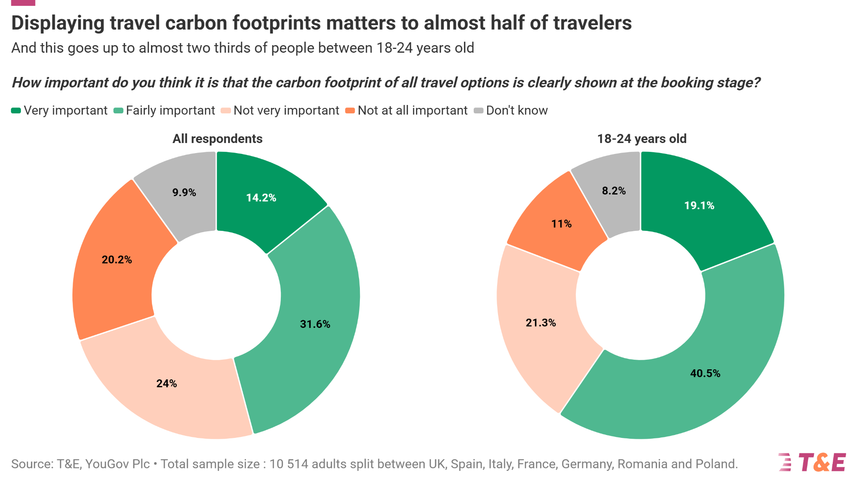
Displaying travel carbon footprints matters to almost half of travelers
This demand rises to 60% among the youngest
Almost half of respondents (46%) think that travel carbon footprint should be displayed on booking engines

Slide 10

Recommendations
The Single Ticketing Package is the window of opportunity to ease the life of European travellers and help them travel with rail. T&E calls to:
1 | Set a mandatory obligation for all rail operators to let all platforms resell their tickets including all fares and extras (bike tickets, seat reservations etc.)
2 | Require major ticketing platforms to display all rail operators in their geographical scope even if from competing rail operators
3 | Require all ticketing platforms to include the climate footprint of the different transport modes in the engine search
4 | Enshire in law a guarantee to be able to go on the next available train if the traveller missed its connecting train due to the first one being delayed
| Opinion poll - rail booking and ticketing

Slide 11
Methodological note
All figures, unless otherwise stated, are from YouGov Plc. Total sample size was 10,514 adults in the UK, France, Germany, Italy, Spain, Poland, and Romania. Fieldwork was undertaken between 4th - 16th September 2025. The survey was carried out online. The figures have been given an even weighting for each country to produce an ‘average’ value.
For the first question, respondents were asked about their rail travel habits for medium- and long-distance journeys. The distances were differentiated as follows:
Medium-distances: 50-300 km
Long-distances: > 300 km
| Opinion poll - rail booking and ticketing

Slide 12


Transport & Environment
Published: 10th October 2025
Authors: Thomas Enriquez, Gonzalo Cachero, Victor Thévenet
Data visualisation: Thomas Enriquez, Cristina Pita
Editeur responsable: William Todts, Executive Director
© 2025 European Federation for Transport and Environment AISBL
To cite this report
Transport & Environment (2025). Opinion poll - rail booking and ticketing
Further information
Gonzalo Cachero - Communications Officer
Transport & Environment
gonzalo.cachero@transportenvironment.org
www.transportenvironment.org
Supported by
| Opinion poll - rail booking and ticketing

