Slide 1


From Ambition to Impact: Safeguarding CEF 3’s Cross-Border Focus
Policy paper
28/01/2026

Slide 2

Expanding the reach of the CEF without endangering EU rail integration
The European Commission has proposed the doubling of the CEF’s resources to meet the higher ambition resulting from the TEN-T’s revision and our mounting climate and security needs.
But resources will still be limited. The CEF 3’s proposal consists of 51.5 billion for transport but costs for the core TEN-T’s deployment are estimated at 515 billion, 10 times more.
| From Ambition to Impact: Safeguarding CEF 3’s Cross-Border Focus

Slide 3
Expanding the reach of the CEF without endangering EU rail integration
The architecture of the new MFF offers a very clear split between EU and national projects. The Connecting Europe Facility should focus on international projects exclusively, while the National and Regional Partnership Plans will cover the national TEN-T sections.
This split has advantages and drawbacks:
While it’s positive to reinforce the CEF’s cross-border basis, there is a possibility that certain Member States may deprioritise national TEN-T sections in favour of other investments.
To avoid this prospect, a comprehensive but focused definition of cross-border projects needs to be applied.
| From Ambition to Impact: Safeguarding CEF 3’s Cross-Border Focus

Slide 4
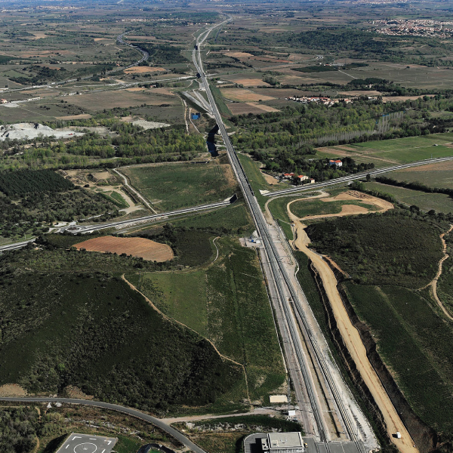


Defining cross-border
A broad scope of cross-border projects to include large cities is welcome
Focusing EU grants on cross-border sections is beneficial, as they often receive the least national support, but without strong links to major cities they risk becoming isolated “white elephants.”
To be competitive cross-border sections must be well connected to major cities, unless they already serve a substantial urban area.
Figure 1: Perpignan-Figures HSL, which only sees a few passenger trains per day
Source: LFP Perthus
| From Ambition to Impact: Safeguarding CEF 3’s Cross-Border Focus

Slide 5
Defining cross-border
Expanding the indicative list of cross-border projects to include major cities along longer international corridors would increase benefits, but only where credible rail links exist.
Proposals such as Stockholm–Turku–Helsinki, which lack a land connection, should not be eligible for CEF funding. True cross-border projects like Rail Nordica should be prioritised instead.
To maintain focus it is important that the list of key projects is defined as preferential. The EU needs to maintain control over the most important cross-border projects, as the limited funding may be diluted otherwise due to an excessive flow towards projects of a higher national interest.
| From Ambition to Impact: Safeguarding CEF 3’s Cross-Border Focus

Slide 6
Maximising the CEF’s budget
Maintaining the CEF 3’s full geographical coverage is a political obligation and a necessity to achieve the TEN-T’s vision, but it will require a proper balance between the new CEF Transport and CEF Military Mobility.
In the current MFF, 44% of the EU’s contribution from military mobility calls went into just 4 countries: Germany, Poland, Lithuania and Latvia. A higher prominence of Central and Eastern European countries is logical, as the EU works on creating a more robust East-West military corridor to defend against urgent threats.
The four priority military corridors created subsequently with NATO will guarantee that military mobility funds are well distributed across all of Europe, but the aforementioned countries are still expected to be the main benefactors. So this has to be balanced out with a CEF Transport that focuses more on Southern European countries.
| From Ambition to Impact: Safeguarding CEF 3’s Cross-Border Focus

Slide 7
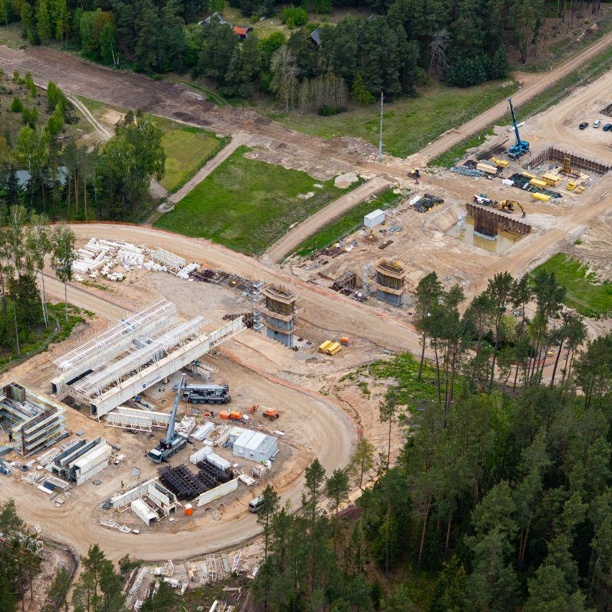
Maximising the CEF’s budget
The ongoing flagship megaprojects constrain the flexibility of CEF Transport.
The proposal by the Commission to reduce the maximum co-funding rate for Cohesion projects from 80% to 75% will be helpful to free up funds for additional projects. While this may seem like a small change, just the single project of Rail Baltica took approximately 20% of CEF Transport’s funds for rail, so a reduction of 5% of the maximum co-funding rate can be significant.
It would also still allow for a big majority of the funding to be potentially covered by the EU, so that projects coming from Member States that have tighter budgets can advance.
Figure 2: Rail Baltica construction in Lithuania
Source: Rail Baltica
| From Ambition to Impact: Safeguarding CEF 3’s Cross-Border Focus

Slide 8
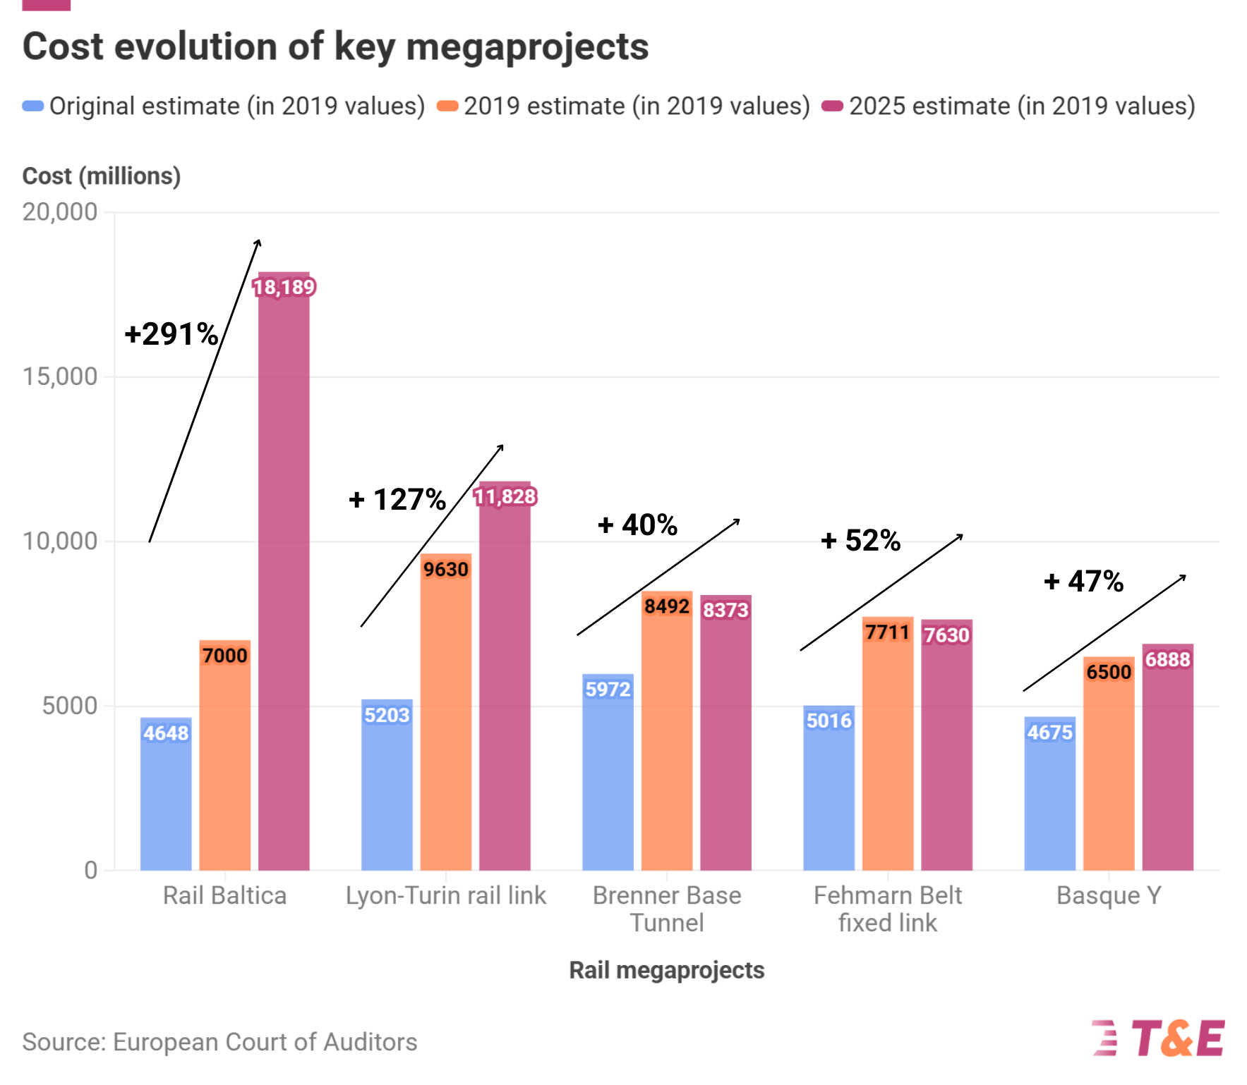

Slide 9
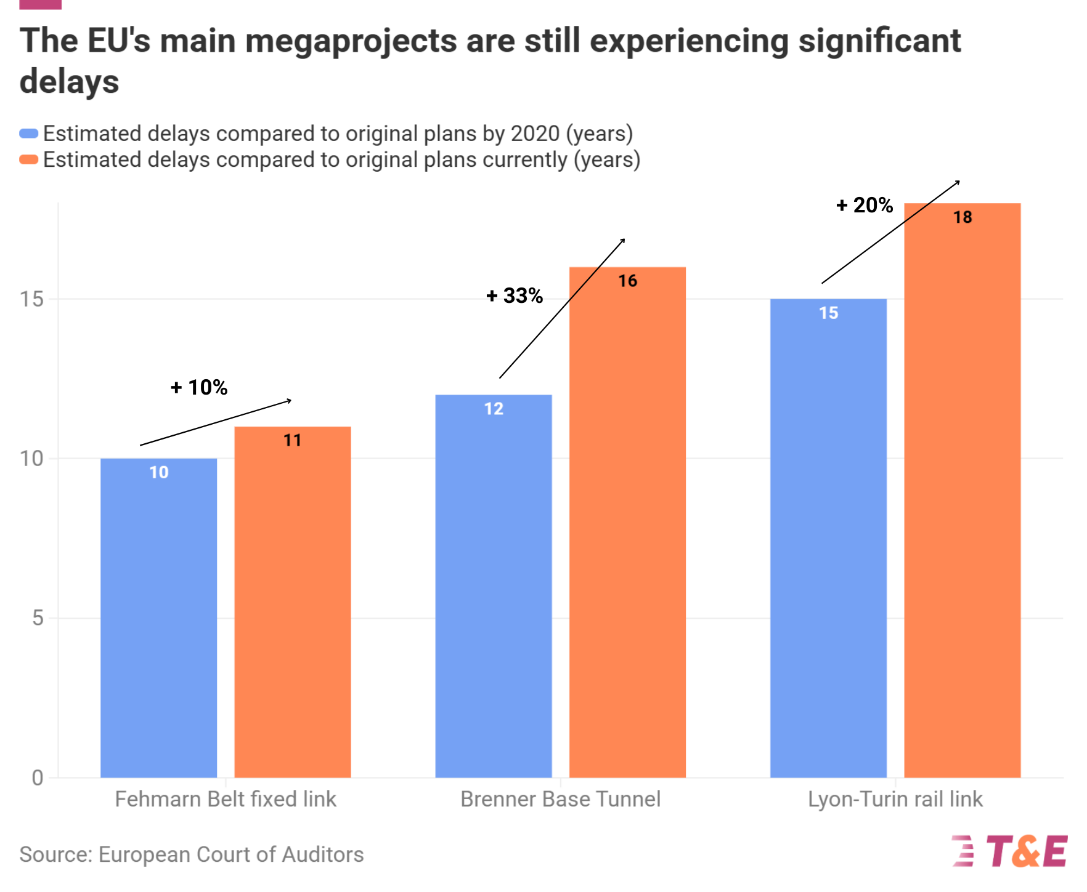

Slide 10
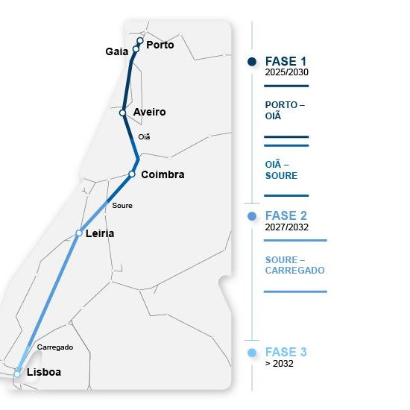
Maximising the CEF’s budget
To prevent further cannibalisation of CEF 3 by flagship megaprojects, award criteria must be strengthened to fund only mature, construction-ready projects.
The Porto–Lisbon high-speed line, the single largest grant of CEF 2 (€813 million), is now delayed due to a proposed relocation of the Gaia station from a central, well-connected site to a peripheral area. This proposal undermines transport policy, threatens the construction timetable, and reduces passenger potential.
Such late changes in EU-funded projects should not be accepted under CEF 3.
Figure 3: Porto-Lisbon HSL
Source: IP
| From Ambition to Impact: Safeguarding CEF 3’s Cross-Border Focus

Slide 11

Recommendations
An ambitious CEF 3 is the only way to achieve the completion of the TEN-T’s core network in a reasonable timeframe. T&E calls to:
1 | Explicitly define the indicative list of cross-border projects as preferential to cement the CEF’s focus on international links
2 | Keep the maximum cohesion co-funding rate at 75% to free up funds for additional projects
3 | Ensure that only mature projects get selected for funding to avoid costly delays that could jeopardise the core network’s conclusion
| From Ambition to Impact: Safeguarding CEF 3’s Cross-Border Focus

Slide 12
Transport & Environment
Published: 28th January 2026
Authors: Carlos Rico
Data visualisation: Thomas Enriquez, Cristina Pita
Editeur responsable: William Todts, Executive Director
© 2025 European Federation for Transport and Environment AISBL
To cite this report
Transport & Environment (2026). From Ambition to Impact: Safeguarding CEF 3’s Cross-Border Focus
Further information
Gonzalo Cachero - Communications Officer
Transport & Environment
gonzalo.cachero@transportenvironment.org
www.transportenvironment.org
| From Ambition to Impact: Safeguarding CEF 3’s Cross-Border Focus

